Slide 1
Nano Activity

Slide 2
Guess my Size!!

Slide 3
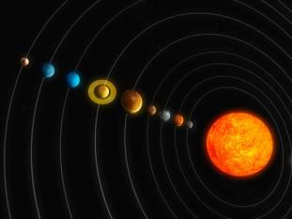
Gigameter (Gm)

Slide 4
Megameter (Mm)

Slide 5
Kilometer (Km)

Slide 6
Hectometer (Hm)

Slide 7
Decameter (Dm)

Slide 8
Meter (m)

Slide 9
Decimeter (dm)

Slide 10
Centimeter (cm)

Slide 11
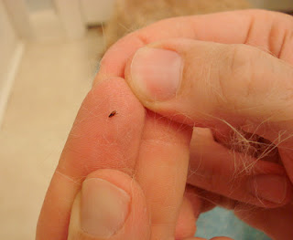
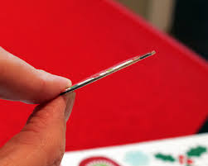
Milimeter (mm)

Slide 12
Micrometer (ϻm)

Slide 13
Nanometer (nm)

